Slide 1


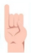
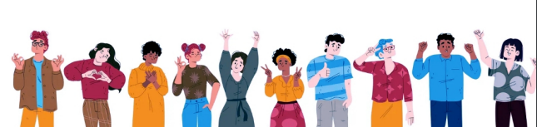
GIVE A S GN

Slide 2

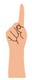
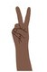
Supervisors
Dr. Esraa M. El-hariri Dr. Asmaa Hashem

Slide 3
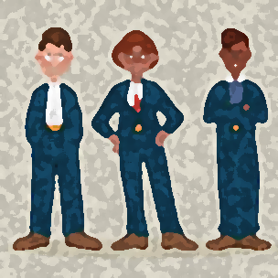
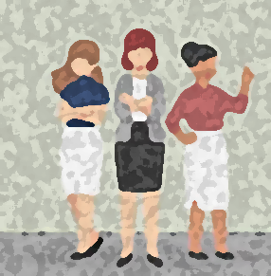
Team member
Omnia nassef
Mohamed Amin
rawan ragab
Hisham Rifaay
Waeir Abdullah
Zahraa Mohamed

Slide 4
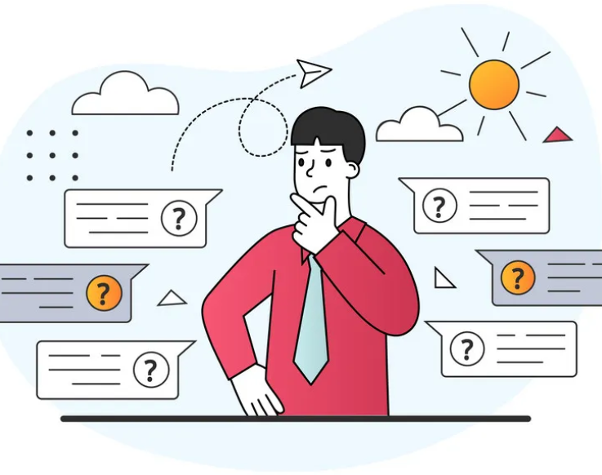
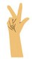
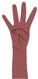
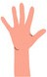
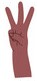
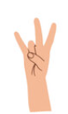
.
Content
Introduction
Problem Definition
project Objective
Related work
The Proposed System
Diagrams
Conclusion and Future work

Slide 5
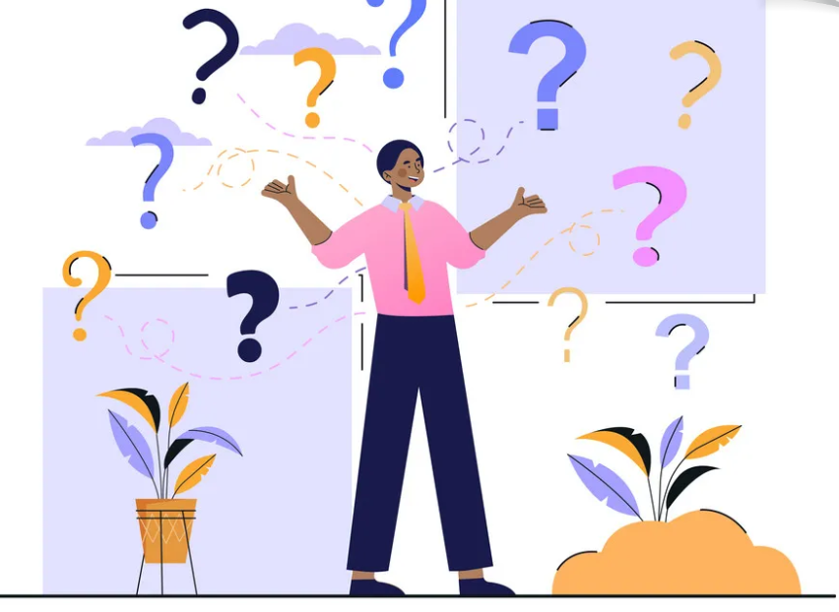
Introduction

Slide 6
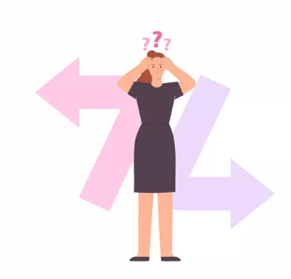
INTRODUCTION
In the world there are many deaf and mute people who suffer from difficulty communicating
Deaf and mute individuals face communication barriers in a predominantly spoken language society.

Slide 7
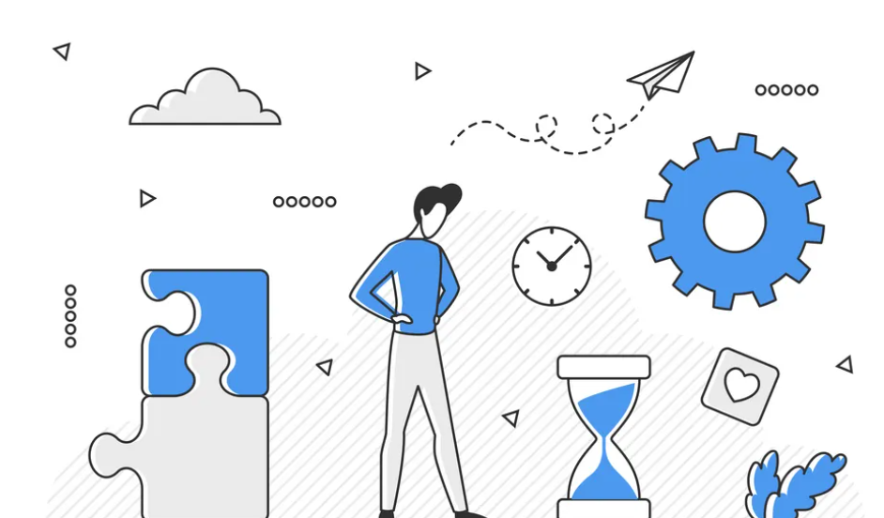
INTRODUCTION
Our mobile app for deaf patients, where patients download the application, log in to it, and they could communicate with others easily.
Where the app converts sign language into text (English , Arabic)

Slide 8

Problem Definition

Slide 9
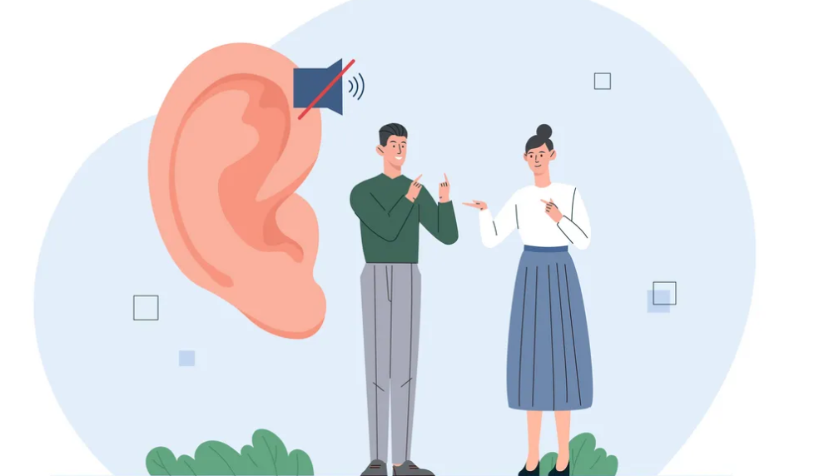
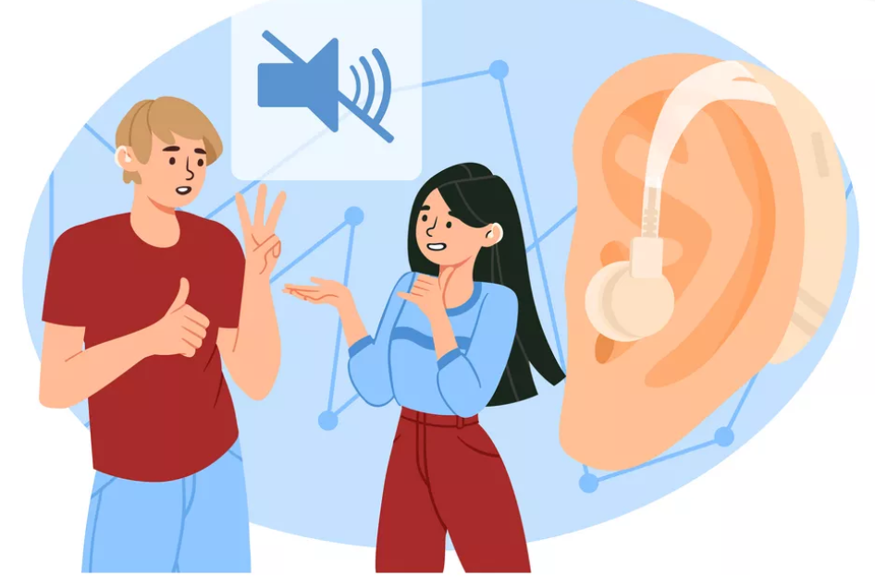
Problem Definition
Lately, the number of patients with Deaf has increased and speeded among all different age generations.
Based on some analytics, we have a vision of
About 8 million Egyptians they suffer from Deaf
This kind of people need special treatment for disability to speak or listen

Slide 10
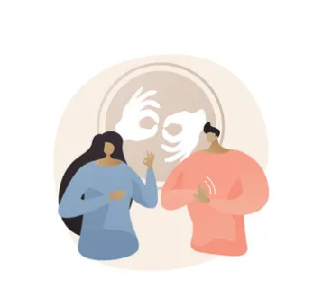
project Objective

Slide 11
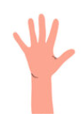
PROJECT OBJECTIVE
Creating sign language recognition automated system
To promote social inclusion by bridging the communication gap between Deaf and hearing individuals
To empower users to communicate effectively through sign language, promote accessibility, and contribute to a more inclusive society.
To provide a resource for learning and practicing sign language for new learners
To offer translation and interpretation services
To provide a comprehensive and easily accessible library of sign language resources

Slide 12
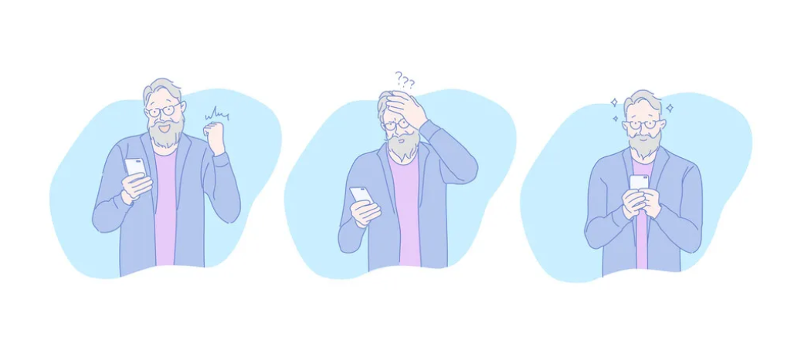
Related work

Slide 13
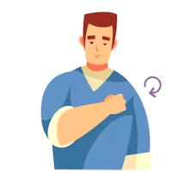
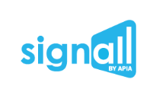
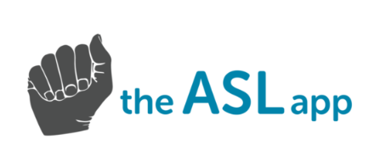


RELATED WORK
Sign Language Recognition and Translation Systems
Mobile Applications for Learning Sign Language

Slide 14
Sign language recognition using the fusion of image and hand landmarks through multi-headed convolutional neural network scientific reports | friendly 3D character, Hand Talk offers automatic translation to Brazilian Sign Language, used by the deaf communities. | Application for Recognizing Sign Language Gestures Based on an Artificial Neural Network
author Refat Khan Pathan, Munmun Biswas, Suraiya Yasmin, Mayeen Uddin Khandaker, Mohammad Salman & Ahmed A. F. Youssef | author Startup with founders Ronaldo Tenório Carlos Wanderlan | author Kamil Kozyra Karolina Trzyniec Ernest Popardowski Maria Stachurska
accuracy test accuracy of 96.29% for the image and 98.42% for hand landmarks | accuracy reached 99% | accuracy reached 99%
dataset ASL Fingerspelling Images (RGB & Depth available at Kaggle |  | dataset Token by author

Slide 15
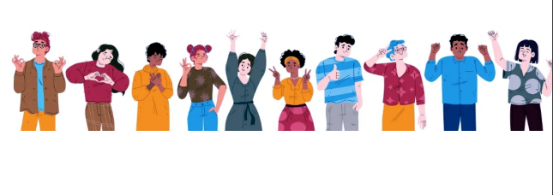
Cont…
paper for American Sign Language Detection using YOLOv5 and YOLOv8
paper for Video Captioning Based on Sign Language Using YOLOV8 Model

Slide 16
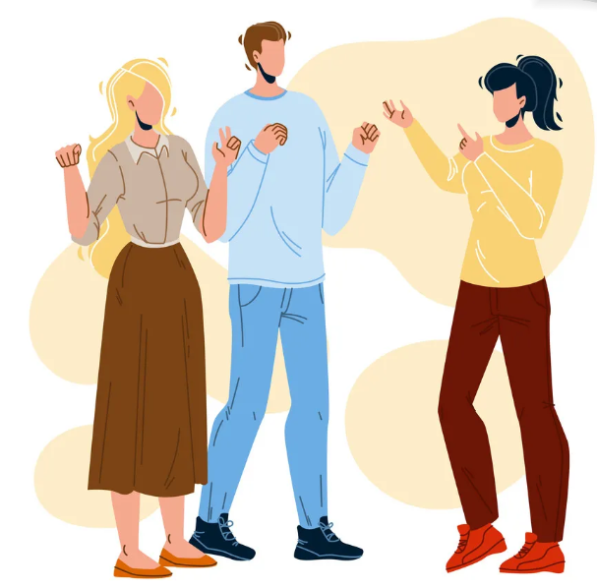
The Proposed System

Slide 17
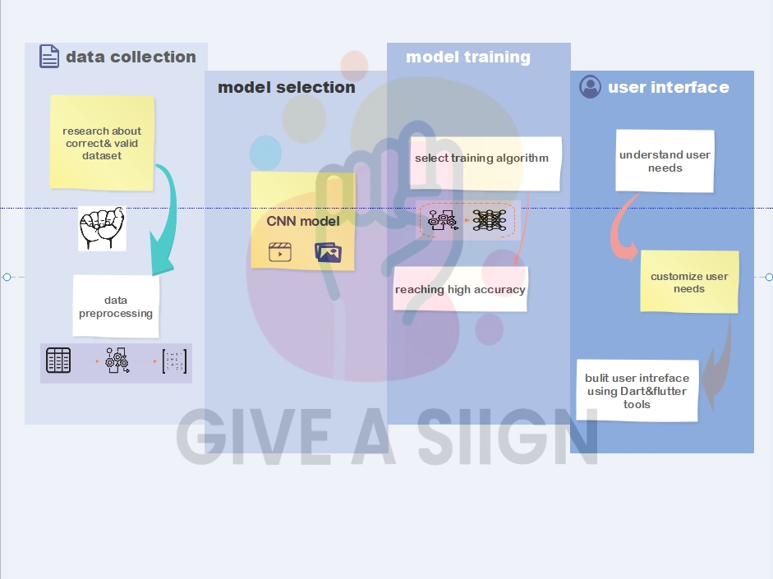


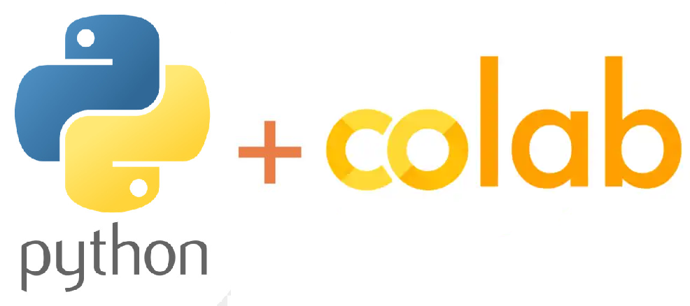
THE PROPOSED SYSTEM
SL detection & recognition
Anutatt data using rowplow
yolov8

Slide 18
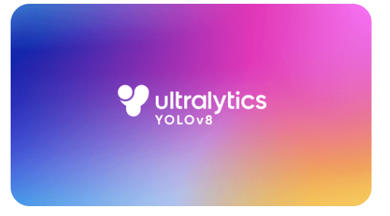
About yolov8
YOLOv8 is a new state-of-the-art computer vision model built by Ultralytics , the creators of YOLOv5. The YOLOv8 model contains out-of-the-box support for object detection, classification, and segmentation tasks, accessible through a Python package as well as a command line interface.

Slide 19

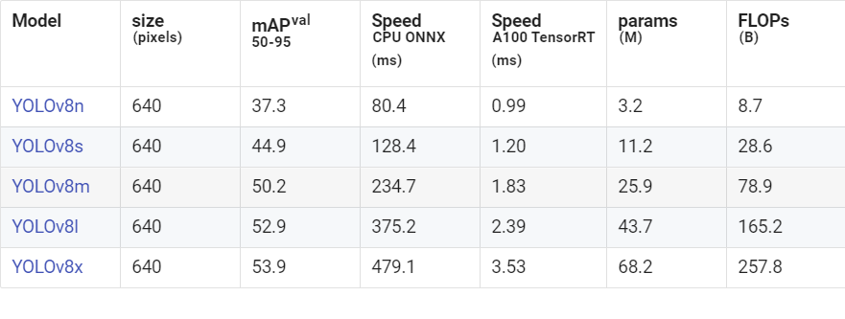
About yolov8

Slide 20

Diagrams

Slide 21
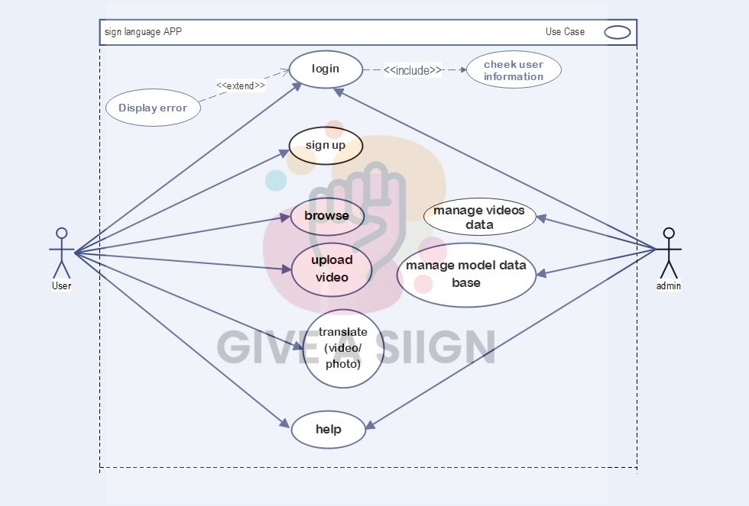
use case diagram

Slide 22
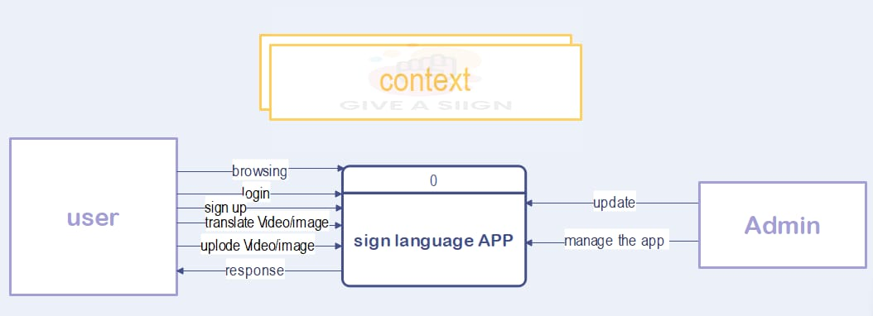
Context diagram

Slide 23
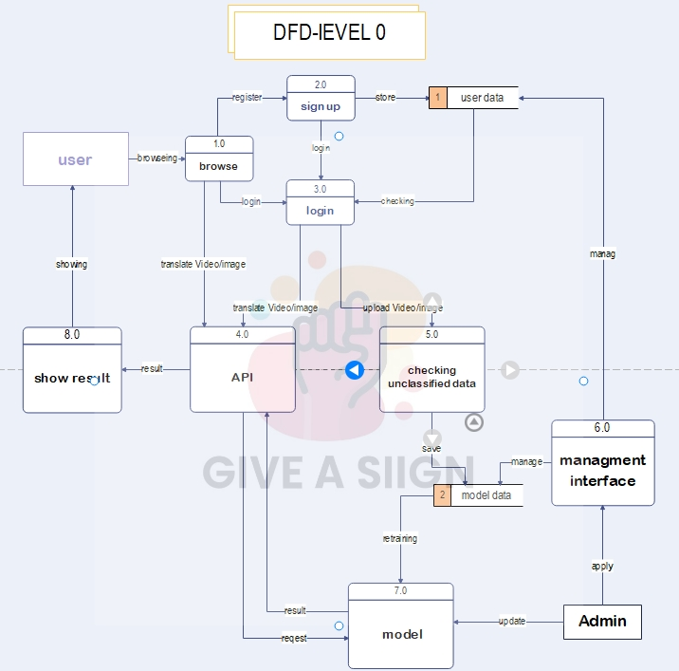
DFD diagram

Slide 24
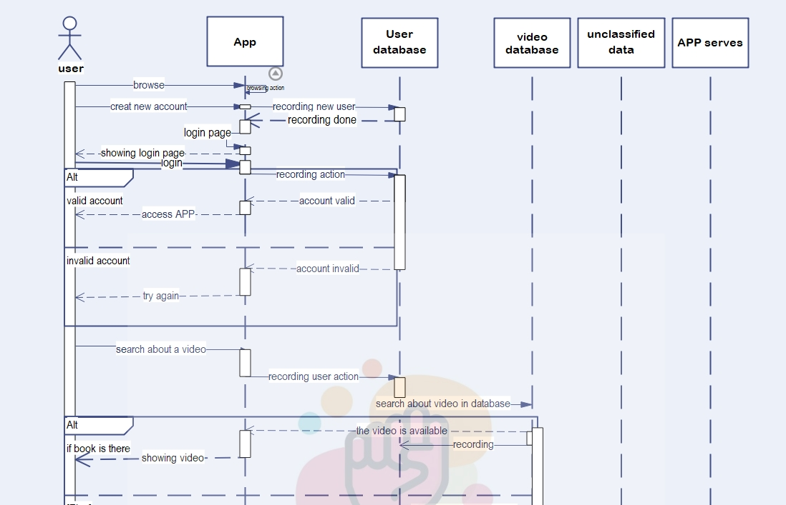
Sequence diagram

Slide 25
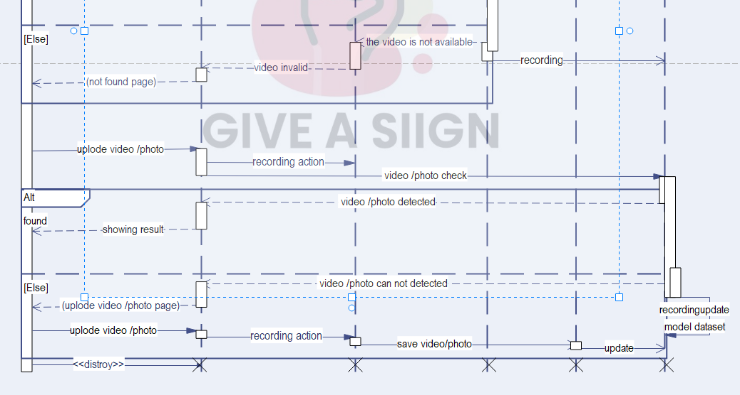
Cont..

Slide 26
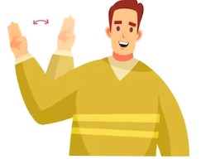
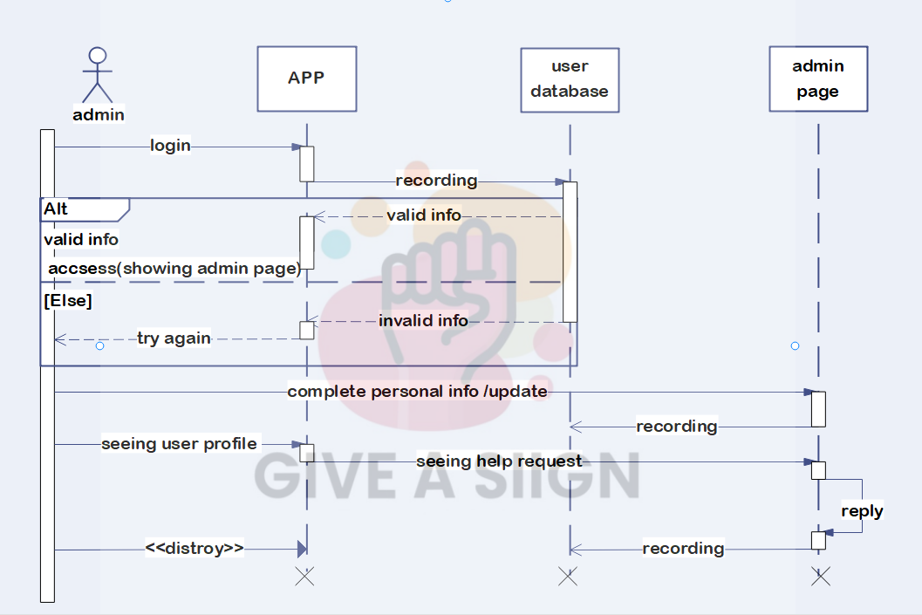
Admin Sequence diagram

Slide 27
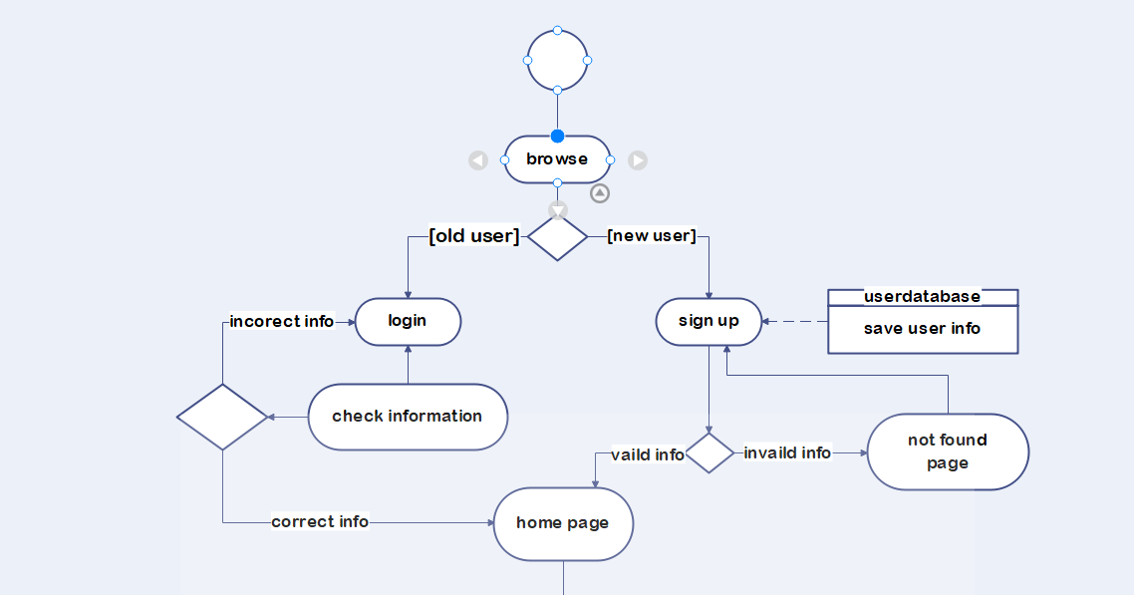
activity diagram

Slide 28
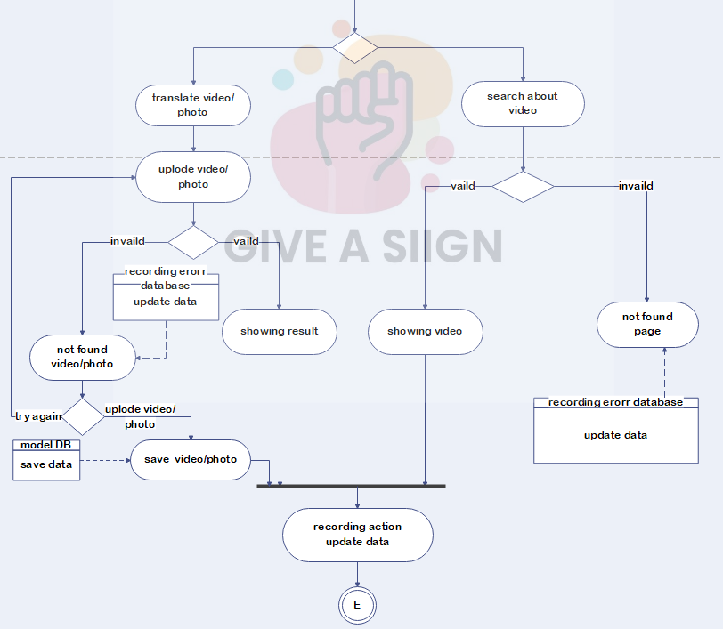
Cont..

Slide 29

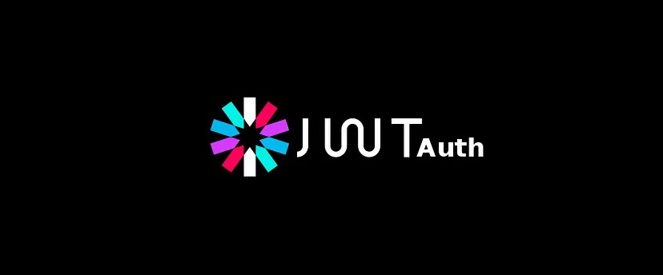
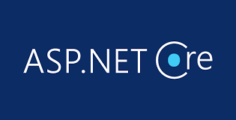

Backend

Slide 30
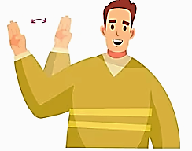
Project Overview:
This project is a REST API backend developed in C# using .Net and the Asp.Net Core7 ,
It supports API functionalities for video management and authentication through JWT tokens.
Technologies Used

Slide 31
Mobile application

Slide 32
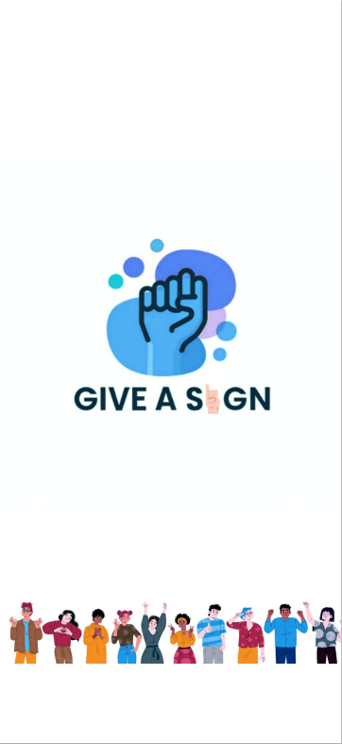
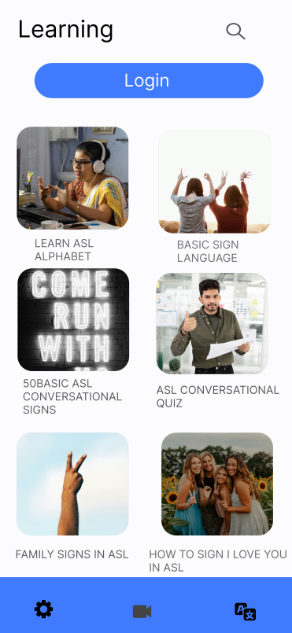
home

Slide 33
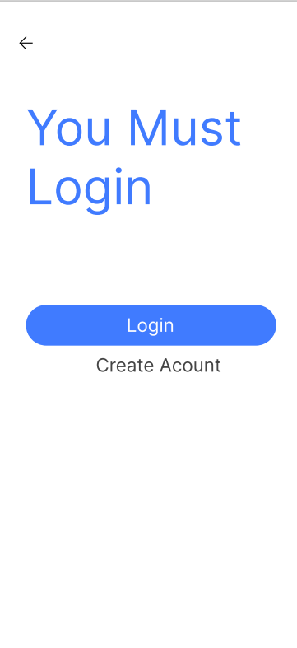
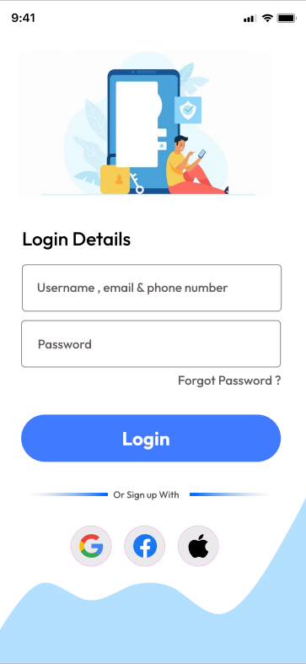
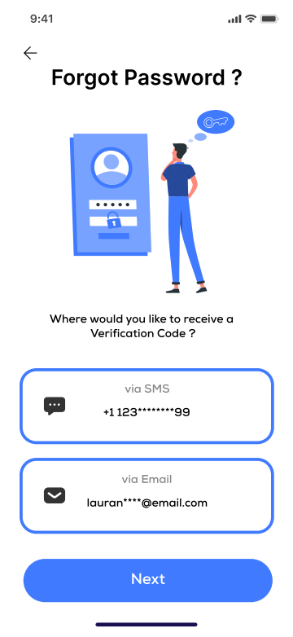
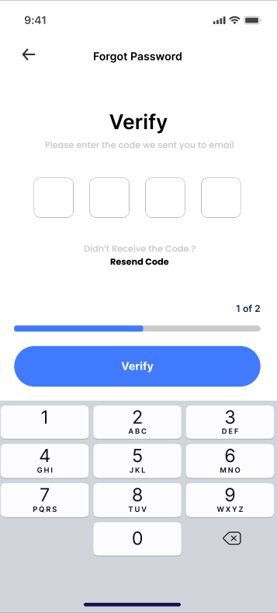
Login & register

Slide 34
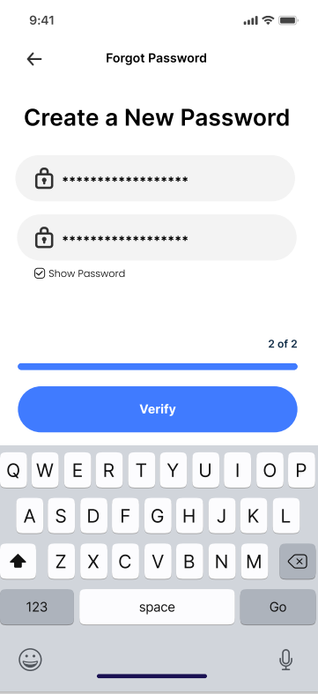
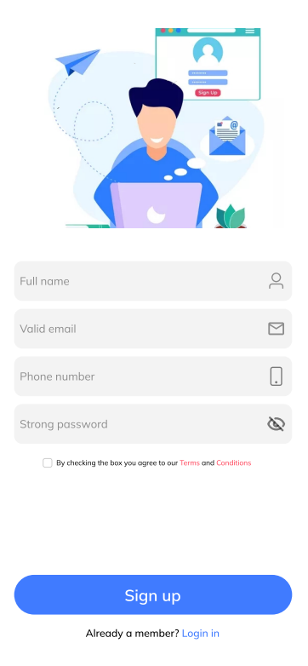
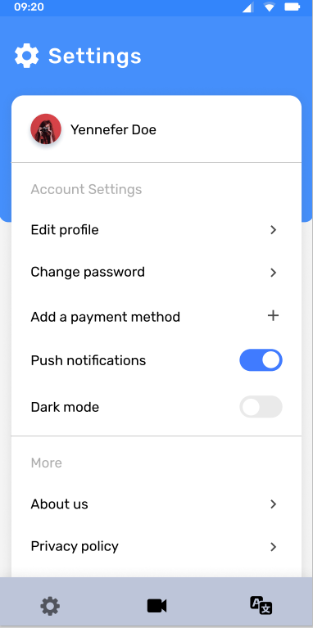
Login & register
setting

Slide 35



translate

Slide 36


When sign is not recognized (no translation found page ) is appear to user that can simply upload video or image to being saved in database to be used later to develop model efficiency

Slide 37

learning

Slide 38

THE EXPERIMENTAL RESULTS & DISCUSSION

Slide 39

About dataset
picture
Primary Dataset
Taking pictures
Annotate pictures
Divided pictures (train , valid , test)

Slide 40


Cont..
Our dataset consists of 2 models including many classes of different stages of different category sign language
Arabic model : total number of images are 1612 of 42 class for Arabic detection and . It is also openly available on the internet. Each class contains approximately 30 image and its label https://universe.roboflow.com/sign-language-6ccbk/en-give-a-sign
R | 98%
MAP50 | 99%
MAP50-95 | 90%

Slide 41



Cont..
English model : total number of images are 941 of 31 class for Arabic detection and . It is also openly available on the internet. Each class contains approximately 30 image and its label https://universe.roboflow.com/sign-language-6ccbk/en-give-a-sign
R | 98%
MAP50 | 99%
MAP50-95 | 91%

Slide 42



One-Stage object detection

Slide 43
Deep Learning object detection Models
Detect objects ( hand)
Classify every single object and estimate its size with a bounding box
One-Stage object detection
Detect image or video in a single pass without explicit region proposal yolov8

Slide 44

Models Result
Arabic model

Slide 45

Cont…

Slide 46

English model

Slide 47

Cont..

Slide 48
Conclusion and Future work

Slide 49

Conclusion
Breaks Down Communication Barriers
Fosters Greater Inclusivity and Understanding
Focus on Further Development
User-Friendly and Accessible Learning Platform
Engaging and Interactive Learning Experience
Rich Cultural Experience
Future Development Opportunities

Slide 50
Future work
Building Natural language processing (NLP) to use letters to make words
Add other words
Add other languages
translate from one sign language to another sign language
Adding the video call feature for deaf and mute patients to
enable easy communication to every one

Slide 51

Thank you

